Slide 1
Unit 1 TurtleLogo
August 20, 2020

Slide 2
What is TurtleLogo?
Logo is a class of languages that have dictionaries of words and are extensible – new words are easily created out of existing words
You can type in Logo words and something happens right away
We will use Turtle Logo as our starting point to get familiar with the way the language works and some basic words and structures in the language
But….Turtle Logo is not the form of Logo that we will be using to talk to the hardware (more later)

Slide 3
Structure of each Lesson Plan
Learning Objectives
Materials List
Vocabulary
Getting Started
Step by Step Instructions
Challenges
Double Dare Challenges
Each has a worksheet for easier grading

Slide 4
Starting a new TurtleLogo Project
If you do not see a black full screen window with questions, (1) click on the black icon at the bottom of your screen, (2) type start and (3) hit the enter key.
Would you like to load an existing experiment? (y/n)
> n
Would you like to create a new experiment (y/n)
> y
Please select an experiment by typing its complete name (eg BasicBoard.tar)
> TurtleLogo.tar
Provide a name for the new experiment folder (eg. MyBasicBoard)
> Turtle-YourName

Slide 5
Starting a previously created TurtleLogo Project
If you do not see a black full screen window with questions, (1) click on the black icon at the bottom of your screen, (2) type start and (3) hit the enter key.
Would you like to load an existing experiment? (y/n)
> y
Which experiment would you like to load?
> Turtle-YourName

Slide 6
The Q&A screen
If you mouse towards the bottom of the screen, it will bring up a row of icons
If the Q&A screen disappears, or you type the wrong answers and need to start over, type
CTRL-ALT-T to open a new terminal window and then type start
The black Q&A screen is running in the terminal window “MATE Terminal”

Slide 7
Lessons in Unit 1
1.1 Introducing TurtleLogo
1.2 TurtleLogo Drawings
1.3 TurtleLogo Words
1.4 Words Within Words
1.5 Variable Inputs to Words
1.6 Turtle Art

Slide 8
Lesson 1.1: Introducing TurtleLogo

Slide 9
1.1 Learning Objectives
Students will be able to identify the three different windows used by TurtleLogo
Students will learn how to clean the drawing field window using the command clean.
Students will learn to drive the turtle using the commands: fd, bk, rt and lt.
Students will learn how to draw specific geometric shapes using the turtle.

Slide 10
STEP 1: Start TurtleLogo Project
Turn on computer
Follow instructions to start a new TurtleLogo project
Write the words you see in the white command center window and describe what you see in the blue drawing field window, when TurtleLogo first starts.

Slide 11
Starting a new TurtleLogo Project
If you do not see a black full screen window with questions, (1) click on the black icon at the bottom of your screen, (2) type start and (3) hit the enter key.
Would you like to load an existing experiment? (y/n)
> n
Would you like to create a new experiment (y/n)
> y
Please select an experiment by typing its complete name (eg BasicBoard.tar)
> Turtle.tar
Provide a name for the new experiment folder (eg. MyBasicBoard)
> Turtle-YourName

Slide 12
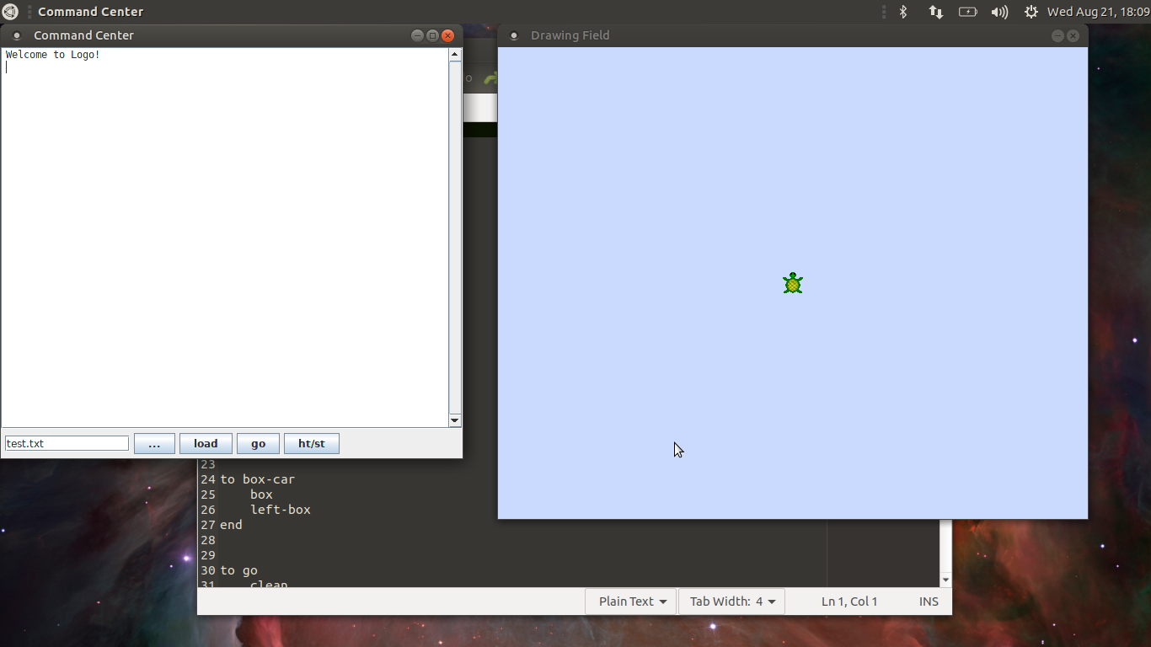
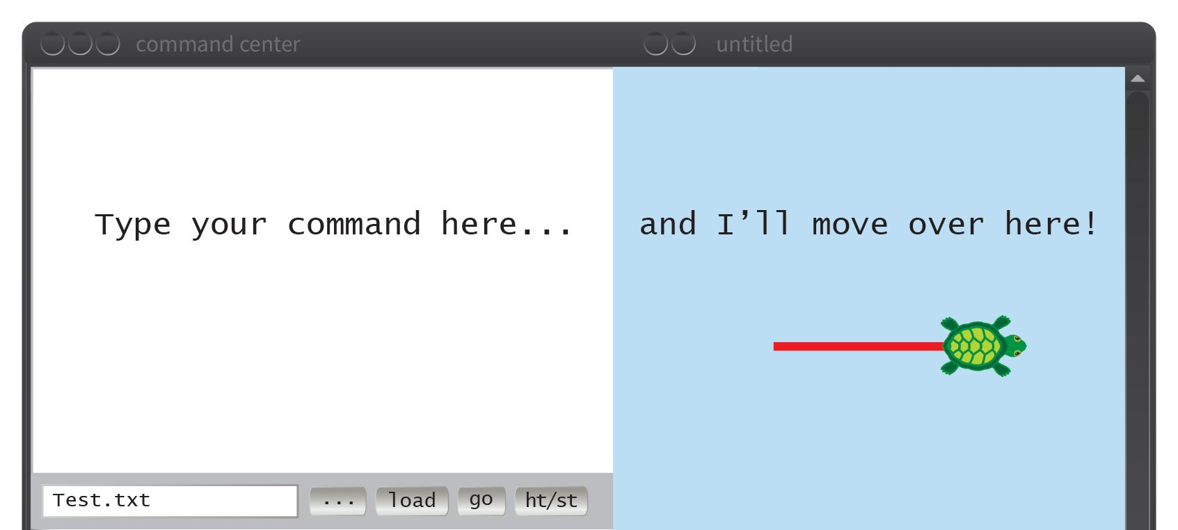
STEP 1: TurtleLogo Windows
Command Center
Where the drawings appear
Type your command here
And I'll move over here.
Turtle
Find a file to load
Load file
Run word “go”
Hide/Show Turtle

Slide 13
STEP 2: Close TurtleWords.txt in the text editor window
Behind the command center and the drawing field is a white
window showing the file TurtleWords.txt. This is the text
editor window (Pluma)
Minimize the command center and drawing field windows by clicking the button in each window’s title bar.
Write down the first line in TurtleWords.txt. Then close the remaining window with TurtleWords.txt by clicking the X button.

Slide 14
STEP 2: TurtleLogo and Pluma open
Editor “Pluma”

Slide 15
STEP 2: Minimize windows
MINIMIZE

Slide 16
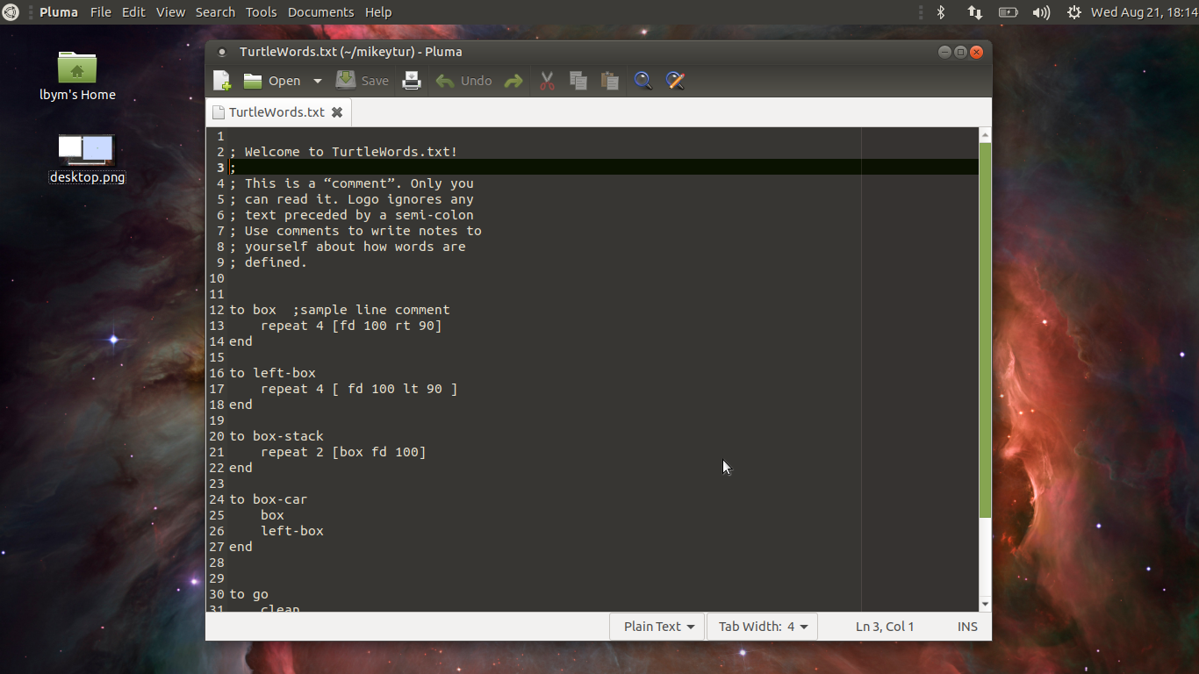
STEP 2: Close Pluma window
CLOSE

Slide 17
STEP 3: Reopen the minimized windows
Click on the penguin icon at the bottom of the screen to reopen the Turtle Windows.
Write what happened on your worksheet.
Click on Duke
Duke the Java Mascot

Slide 18
STEP 3 : Reopen the minimized windows
Command Center
Where the drawings appear
Type your command here
And I'll move over here.
Turtle
Find a file to load
Load file
Run word “go”
Hide/Show Turtle

Slide 19
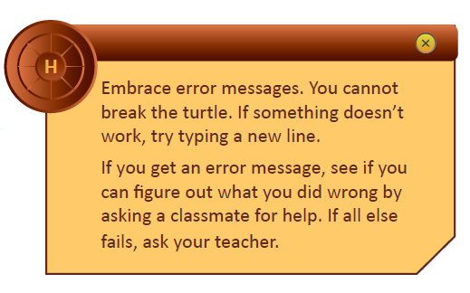
STEP 4: Moving the turtle forward
Clean the drawing field using clean
Move the turtle forward 200 steps
Type fd 200
Hit the enter key
Write the direction the turtle is facing after it is done moving
(up, down, left or right?)

Slide 20
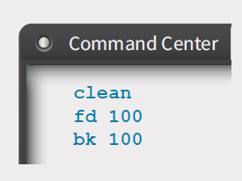
STEP 5: Making the turtle move
Type these commands
Write what happens in the table on the worksheet

Slide 21
STEP 5: Making the turtle move

Slide 22
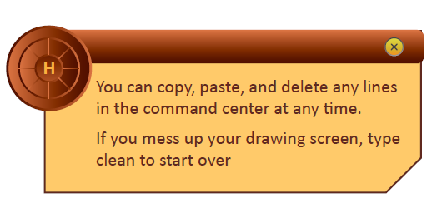
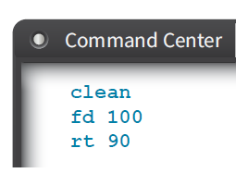
STEP 6: Turning the turtle
Type these commands
What direction is the Turtle facing after it is done moving?
(up, down, left or right?)

Slide 23
STEP 7: Other ways to move the turtle
The words fd and bk take input numbers that tell the turtle how many steps to take.
The words lt and rt tell the turtle how many degrees to turn, starting from the initial direction that the turtle is facing.
Clean the drawing field
Experiment with fd, bk, lt and rt to make the turtle move in different directions.
On your worksheet, fill out the table with at least five words that you used.
Explain what the turtle did and also sketch a small picture of what the turtle drew.

Slide 24
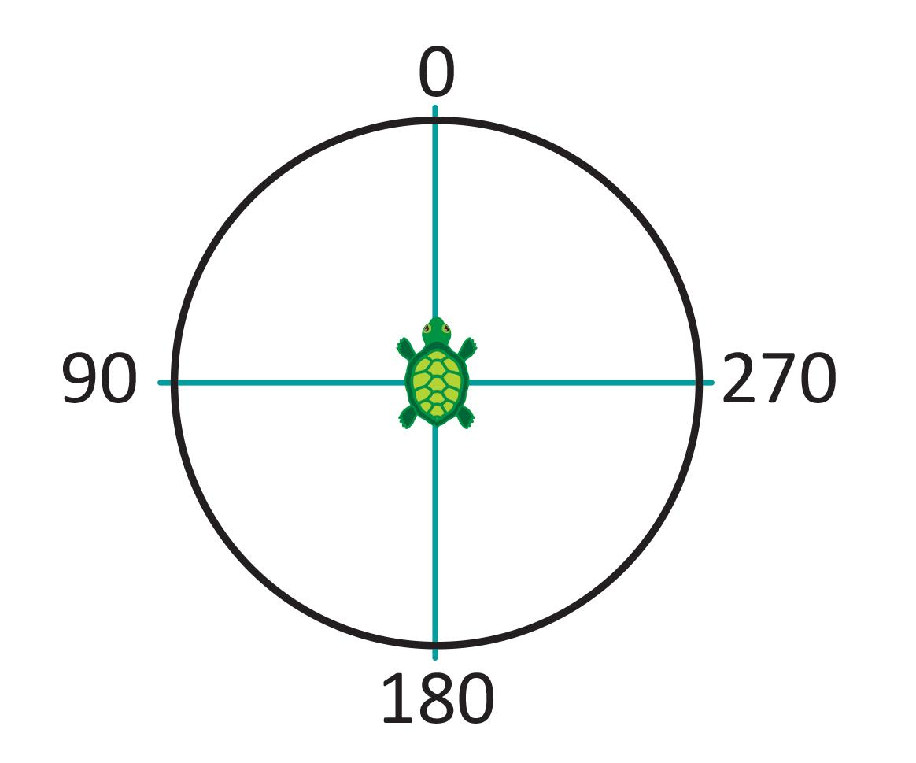
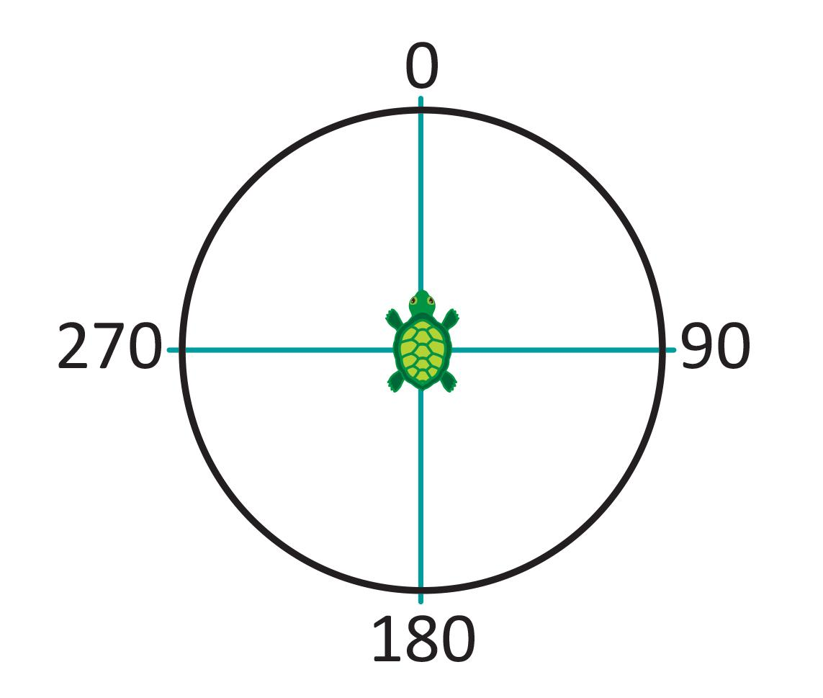
STEP 7: Understanding the turn angles
lt
rt

Slide 25
STEP 7: Other ways to move the turtle

Slide 26
STEP 8: Draw a line that changes directions
Clean the drawing field again.
Experiment with all four commands: fd, bk, lt and rt.
The goal is to draw a line that turns and goes in a different direction.
Write down the sequence of commands that you used to draw a line that changes direction.
Also sketch the results.

Slide 27
Challenge C-1

Slide 28
Challenge C-2

Slide 29
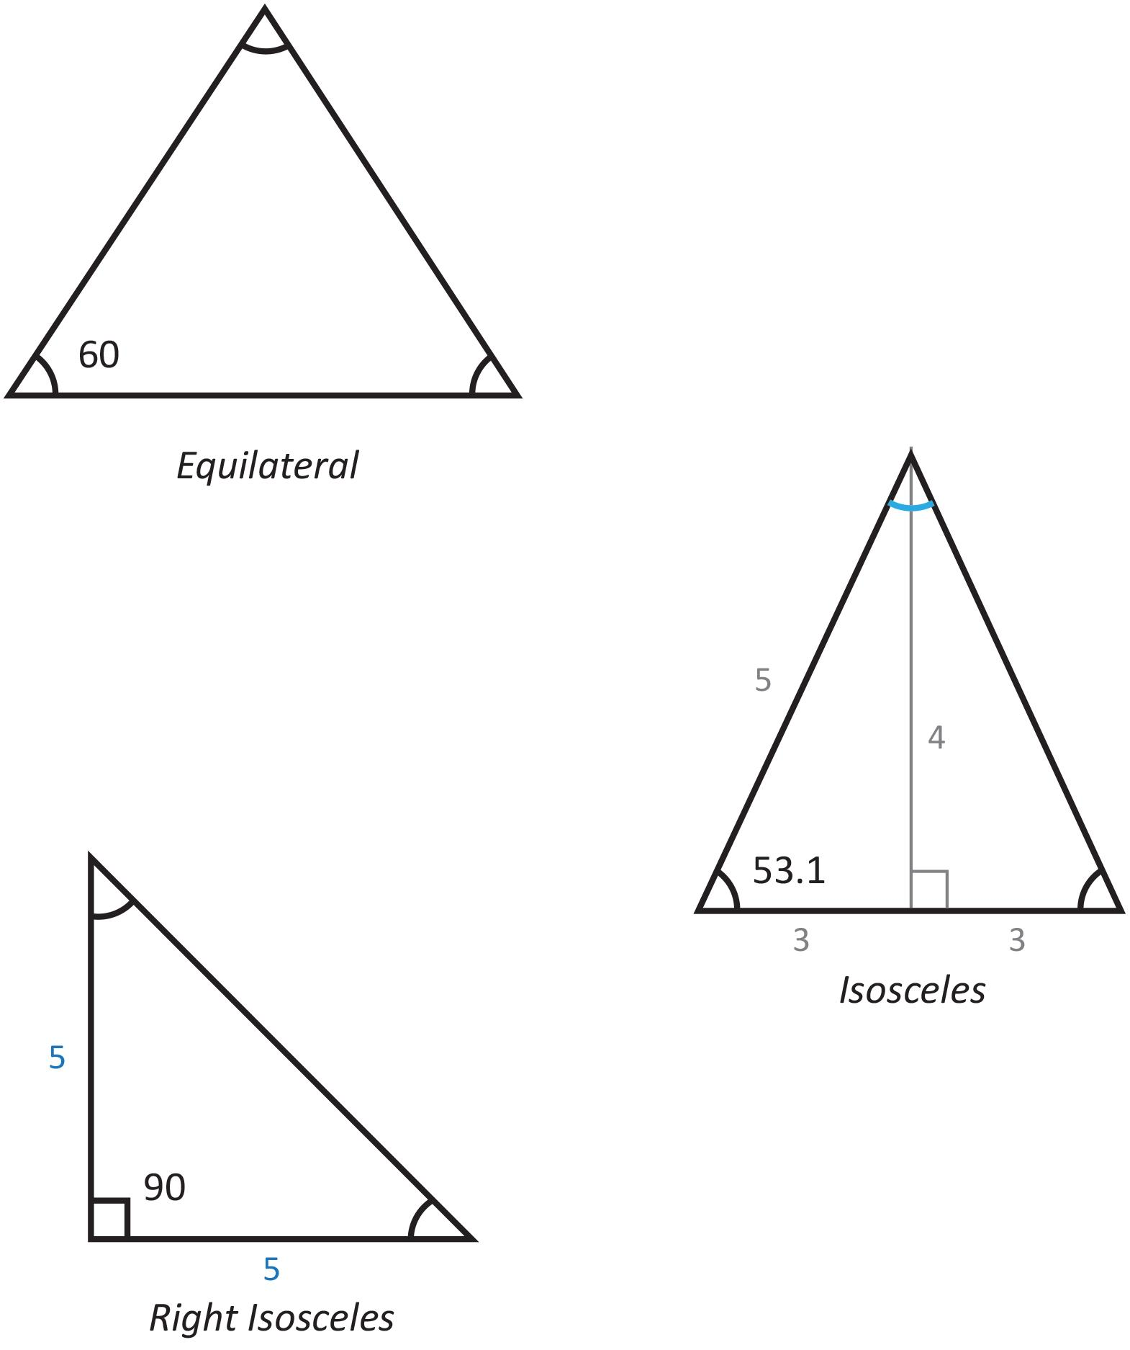
Geometry Review
The sum of the 3 internal angles is 180 degrees
Equilateral: has 3 sides that are the same length and three equal angles
Isosceles: has 2 sides that are the same length, and 1 side that is different. The angles opposite the equal length sides are equal.
Right: has one internal angle that is 90 degrees.
Notes:
Needs new triangle figure
‹#›

Slide 30
Challenge C-3: Triangles: fill in the missing angles

Slide 31
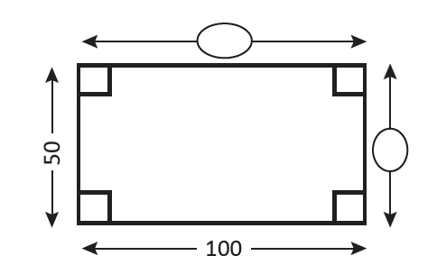
Challenge C-3: Rectangles: fill in the missing sides
Rectangle: has 4 sides and four 90 degree angles
Square: all 4 sides are the same length
Notes:
Needs new triangle figure
‹#›

Slide 32
Challenge C-3: Geometry Worksheet - Polygons
Regular polygons have at least 3 sides
Each side is the same length
To draw a regular polygon, turn the turtle by:
Triangle:
angle = 360/3 = 120
Square:
angle = 360/4 = 90

Slide 33
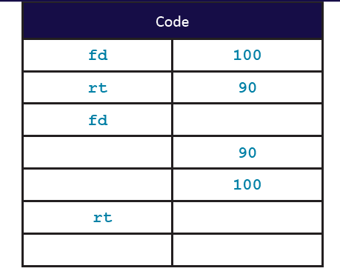
Challenge C-3: Polygons: fill in the table
Fill in the commands needed to make a square

Slide 34
Double Dare Challenge D-1

Slide 35
Double Dare Challenge D-2

Slide 36
Double Dare Challenge D-3

Slide 37
Double Dare Challenge D-4

Slide 38
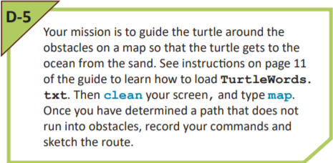
Double Dare Challenge D-5

Slide 39
Lesson 1.2: TurtleLogo Drawings
Notes:
1.2 TurtleLogo Drawings
1.3 TurtleLogo Words
1.4 Words Within Words
1.5 Variable Inputs to TurtleLogo Words
1.6 Turtle Art
‹#›

Slide 40
1.2 Learning Objectives
Students will learn how to fill the screen with a single color using fillscreen
Students will learn how to change the colors drawn by the turtle using setcolor
Students will learn how to change the width of the lines using setpensize
Students will learn how to move the turtle to specified screen locations using setxy
Students will learn how to start and stop the turtle from drawing lines using pendown and penup

Slide 41
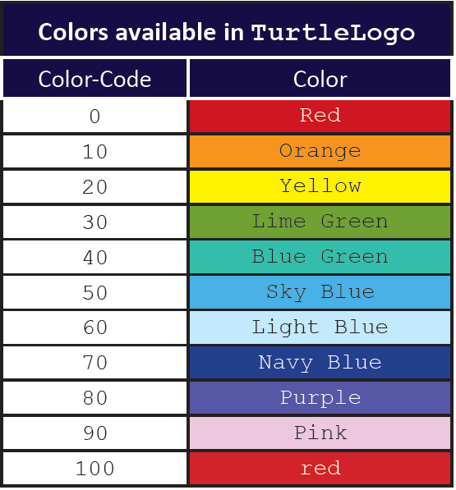
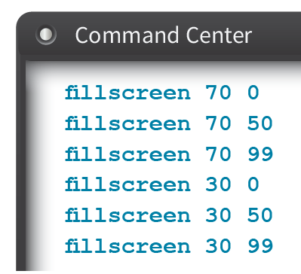
Changing Colors
Try changing the background color:
First input is color
Second input is shade
Shades vary from 0 (darkest) to 99 (lightest)

Slide 42
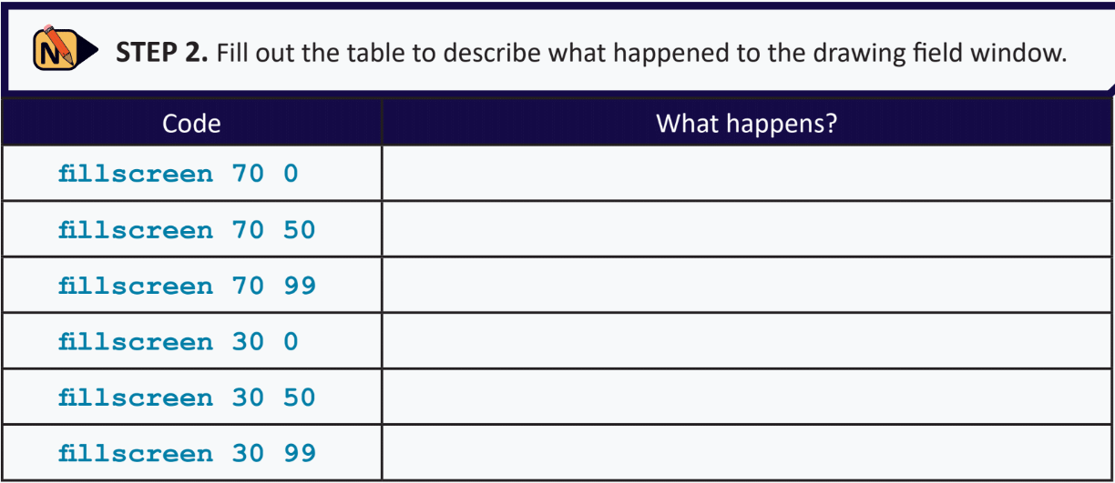
STEP 2: Change The Background Color
Notes:
Note: Turtle turns left after going forward in left hand image.
Image on the right is one possible solution to C-1.
‹#›

Slide 43
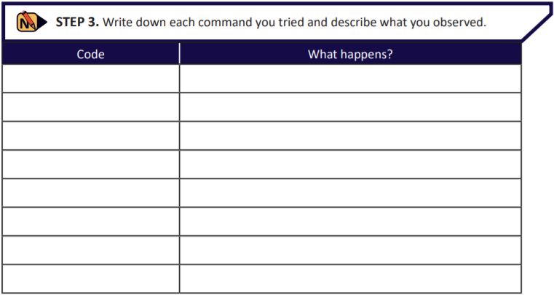
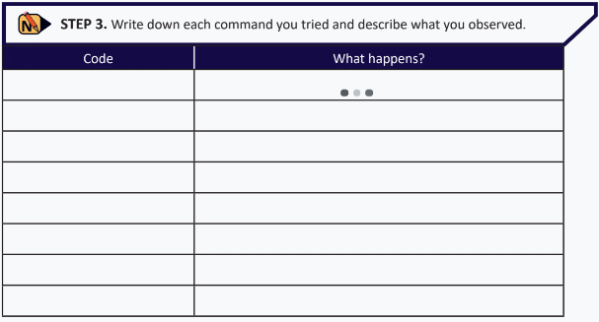
STEP 3: Experimenting with colors
Notes:
Note: Turtle turns left after going forward in left hand image.
Image on the right is one possible solution to C-1.
‹#›

Slide 44
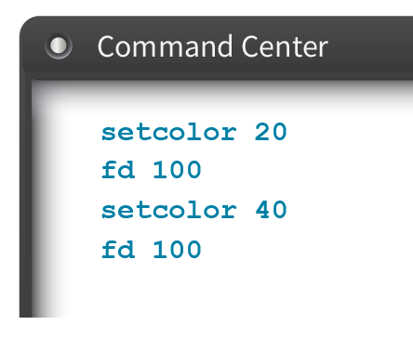
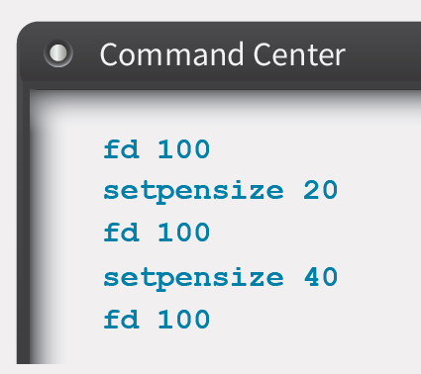
Changing Line Color and Width
setcolor uses the codes in the color chart as input
Default color for Turtle ink is 0 (red)
setpensize changes the width of the line drawn by the Turtle (in pixels)
Default pensize for Turtle ink is 5 pixels

Slide 45
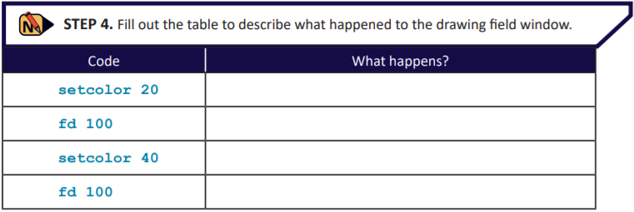
STEP 4: Drawing Lines of Different Colors
Notes:
Note: Turtle turns left after going forward in left hand image.
Image on the right is one possible solution to C-1.
‹#›

Slide 46
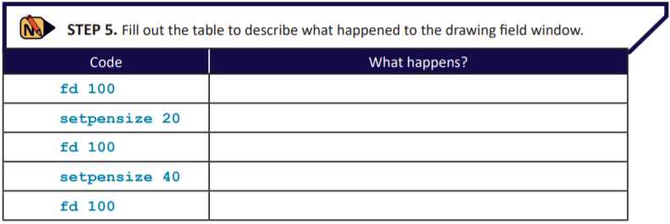
STEP 5: Drawing Lines of Different Widths
Notes:
Note: Turtle turns left after going forward in left hand image.
Image on the right is one possible solution to C-1.
‹#›

Slide 47
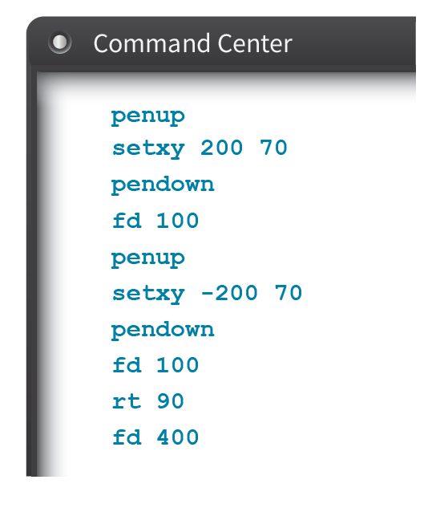
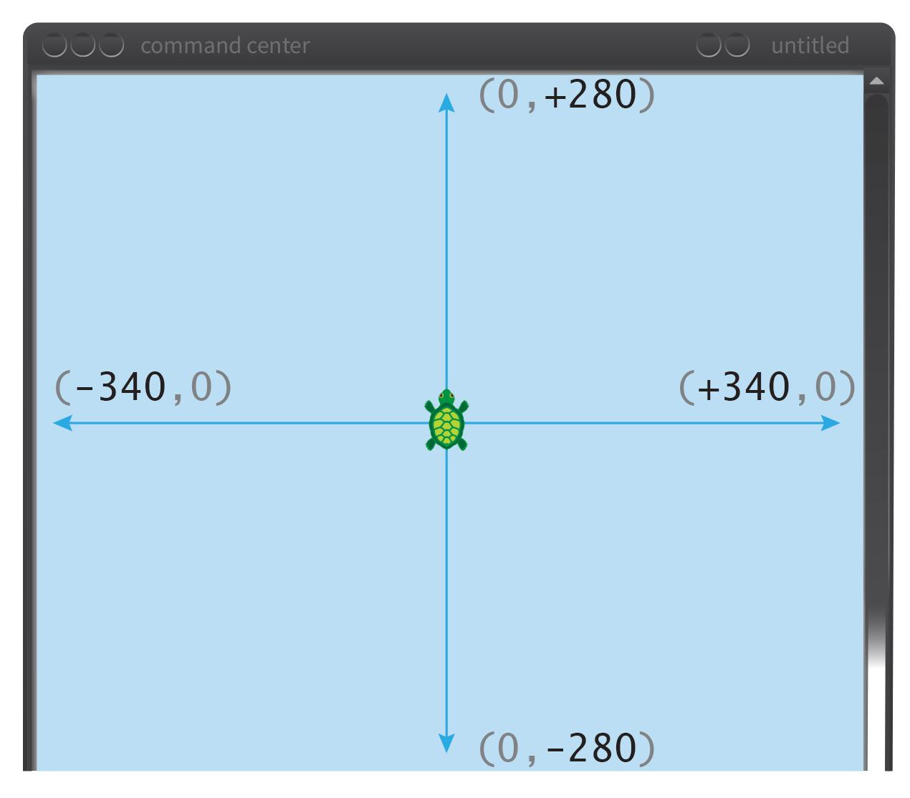
Moving around the screen
penup and pendown control whether or not Turtle draws a line
setxy puts the Turtle at a specific location

Slide 48
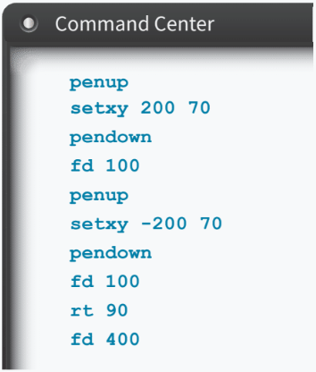
STEP 6: Moving around the screen
Clean the screen, and then type in the following sequence of commands.
Notes:
Note: Turtle turns left after going forward in left hand image.
Image on the right is one possible solution to C-1.
‹#›

Slide 49
Challenge C-1

Slide 50
Challenge C-2

Slide 51
Challenge C-3

Slide 52
Double Dare Challenge D-1

Slide 53
Double Dare Challenge D-2

Slide 54
Double Dare Challenge D-3

Slide 55
Double Dare Challenge D-4

Slide 56
Lesson 1.3: TurtleLogo Words
Notes:
1.3 TurtleLogo Words
1.4 Words Within Words
1.5 Variable Inputs to TurtleLogo Words
1.6 Turtle Art
‹#›

Slide 57
1.3 Learning Objectives
Students will learn how to create loops using the repeat command
Students will learn how to use the text editor to modify commands and add new ones
Students will learn how to control the speed of the turtle using the wait command

Slide 58
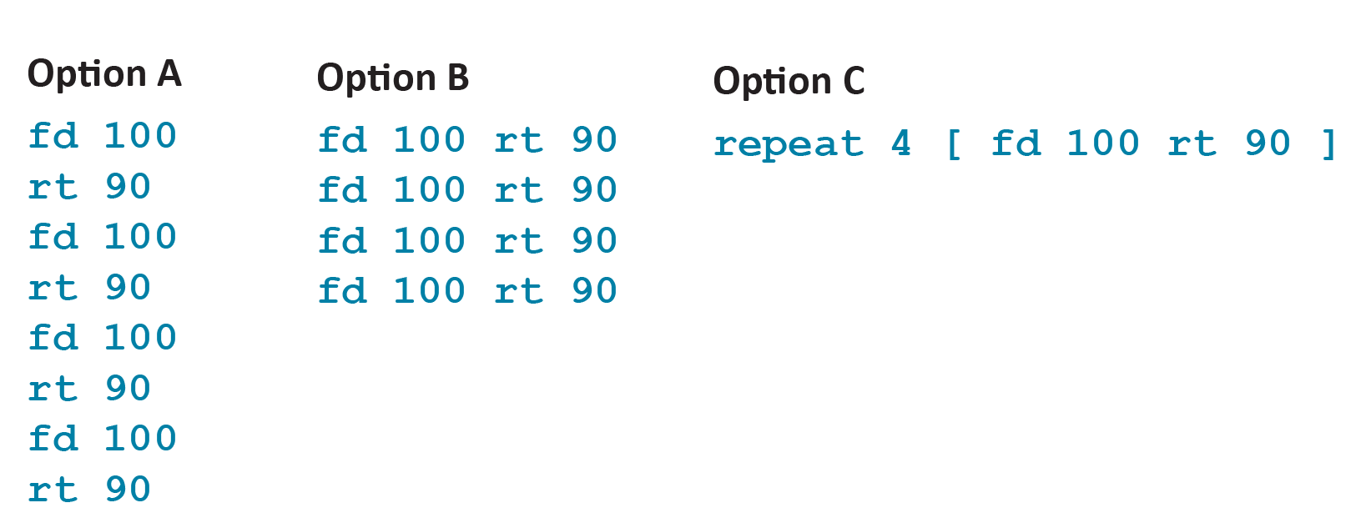
STEP 2: Code Comparison

Slide 59
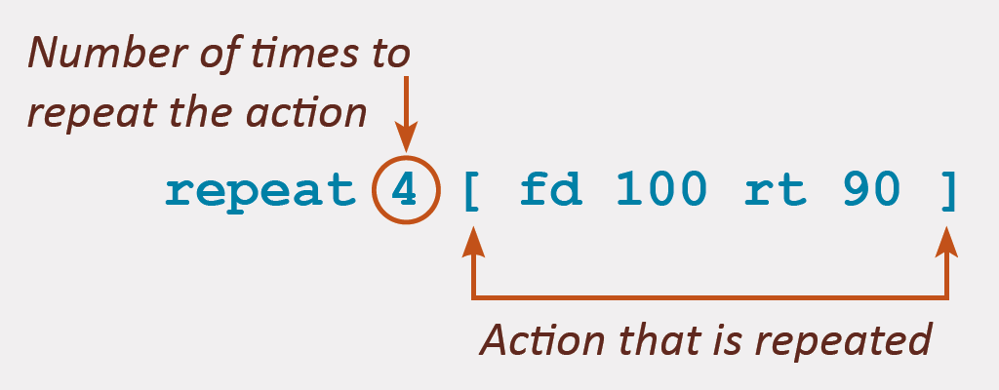
STEP 3: Understanding repeat
This is option C
Leave spaces between each word to make sure the Turtle understands the commands

Slide 60
STEP 3:Understanding repeat
Use the repeat word to draw an equilateral triangle with sides that are 100 steps long.

Slide 61
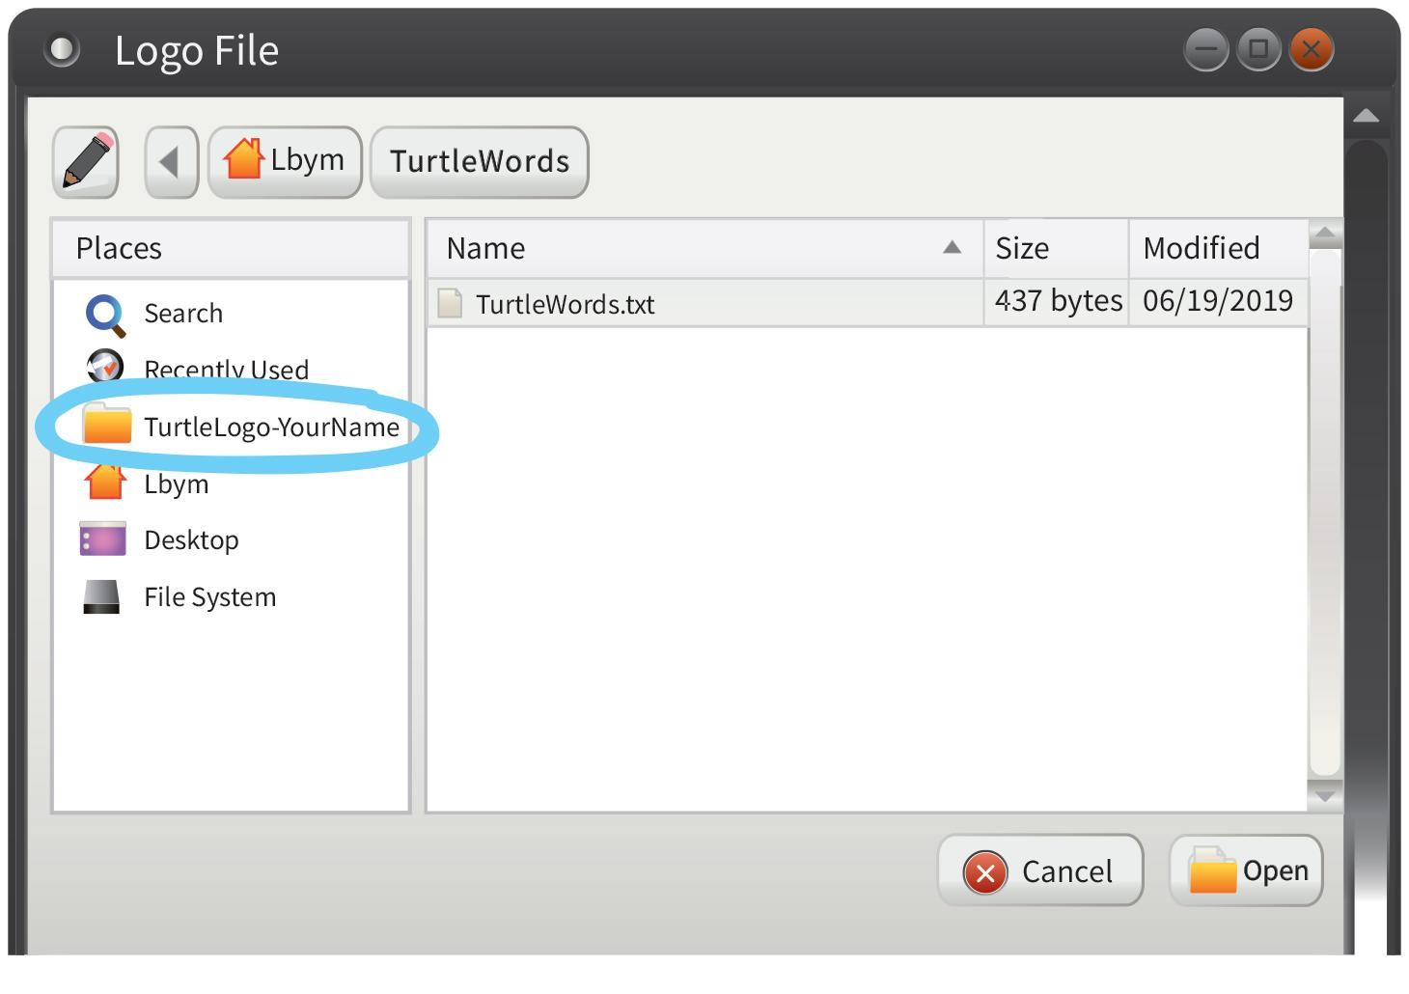
STEP 4: Using the Pluma editor

Slide 62
STEP 4: Finding the TurtleWords.txt File

Slide 63
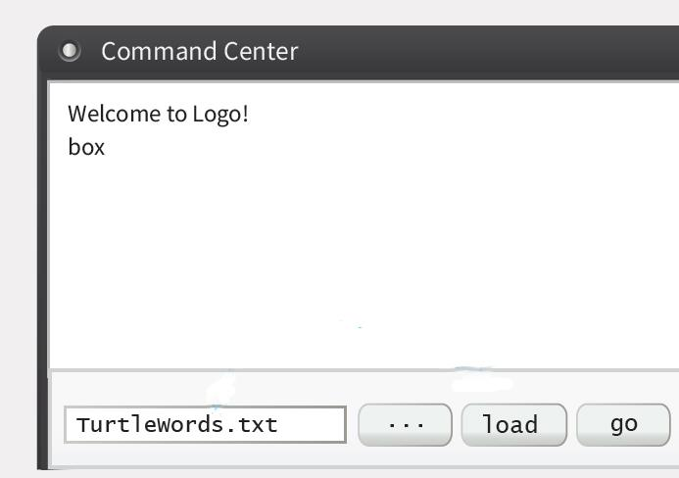
STEP 5: Loading the edited file
After you Open the file, its name should appear in the Command Center input area
Click load button to add the words in TurtleWords.txt to your dictionary
Try running the word box

Slide 64
STEP 5: Loading the TurtleWords.txt File

Slide 65
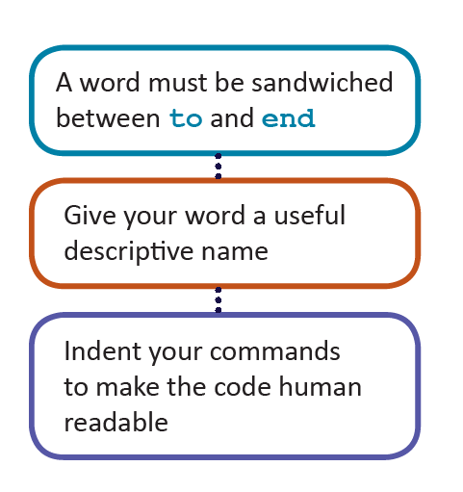
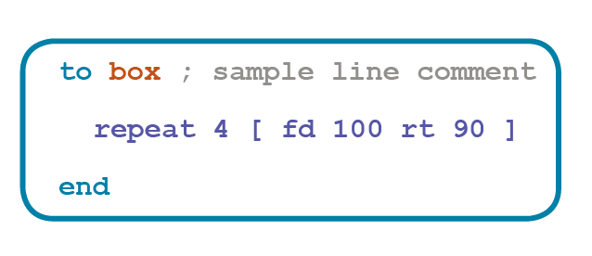
STEP 6: Defining new words
Add comments to your code so you remember what it does
Everything after a semicolon ; is a comment and is not executed

Slide 66
STEP 6: Defining new words

Slide 67
STEP 7: Defining new words

Slide 68
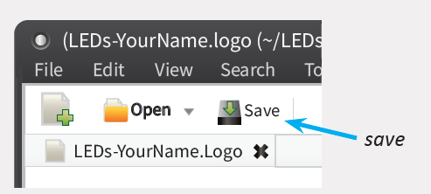
STEP 7: Saving changes to TurtleWords.txt
Save the file after editing it
Minimize the Pluma window
Click load button in command center
Run your edited word

Slide 69
STEP 8: Add a Comment to Your Code

Slide 70
Challenge C-1

Slide 71
Challenge C-2

Slide 72
Challenge C-3

Slide 73
Challenge C-4

Slide 74
Challenge C-5

Slide 75
Double Dare Challenge D-1

Slide 76
Double Dare Challenge D-2

Slide 77
Double Dare Challenge D-3

Slide 78
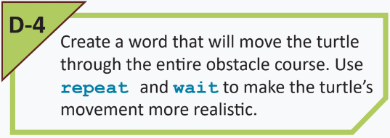
Double Dare Challenge D-4

Slide 79
Lesson 1.4: Words Within Words
Notes:
1.5 Variable Inputs to TurtleLogo Words
1.6 Turtle Art
‹#›

Slide 80
1.4 Learning Objectives
Students will learn how to use the go icon in the command center window
Students will learn how to make new commands out of simpler ones
Students will gain familiarity with the text editor and will use it to edit the TurtleWords.txt file to modify old words and to create new words

Slide 81
Using the Pluma editor

Slide 82
Loading the edited file
After you Open the file, its name should appear in the Command Center input area
Click load button to add the words in TurtleWords.txt to your dictionary
Try running the word box

Slide 83
Using the go button
The command center has a special button labeled go
When you click the go button, it runs the word go in TurtleWords.txt
If you add a new word or change the definition of any words in TurtleWords.txt, and want to see the new actions, remember to Save the file, and load it before running the new words

Slide 84
STEP 3: Running the Word go

Slide 85
STEP 4: What does go do?

Slide 86
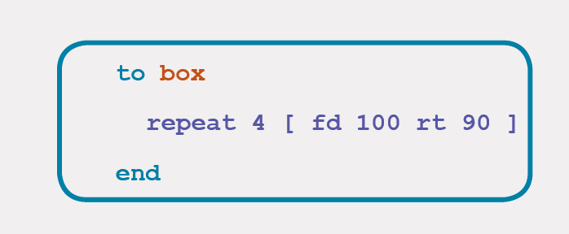
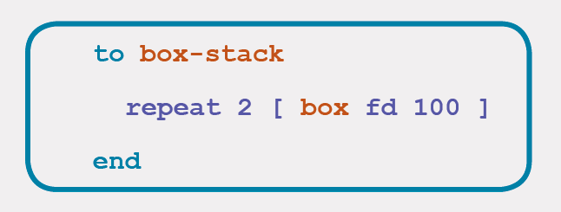
Words within words
The previously defined word box is used in the new word box-stack.
What do you think box-stack does?

Slide 87
STEP 5: Code Comparison

Slide 88
STEP 6: Running the words

Slide 89
STEP 7: Create your own word

Slide 90
Challenge C-1

Slide 91
Challenge C-2

Slide 92
Challenge C-3

Slide 93
Double Dare Challenge D-1

Slide 94
Double Dare Challenge D-2

Slide 95
Double Dare Challenge D-3

Slide 96
Double Dare Challenge D-4

